Slide 1
Building with Redux Toolkit Toolkit

Slide 2
Middleware Unidirectional Flow
Single Immutable State Tree DevTools
Redux Features

Slide 3
How Redux Works

Slide 4
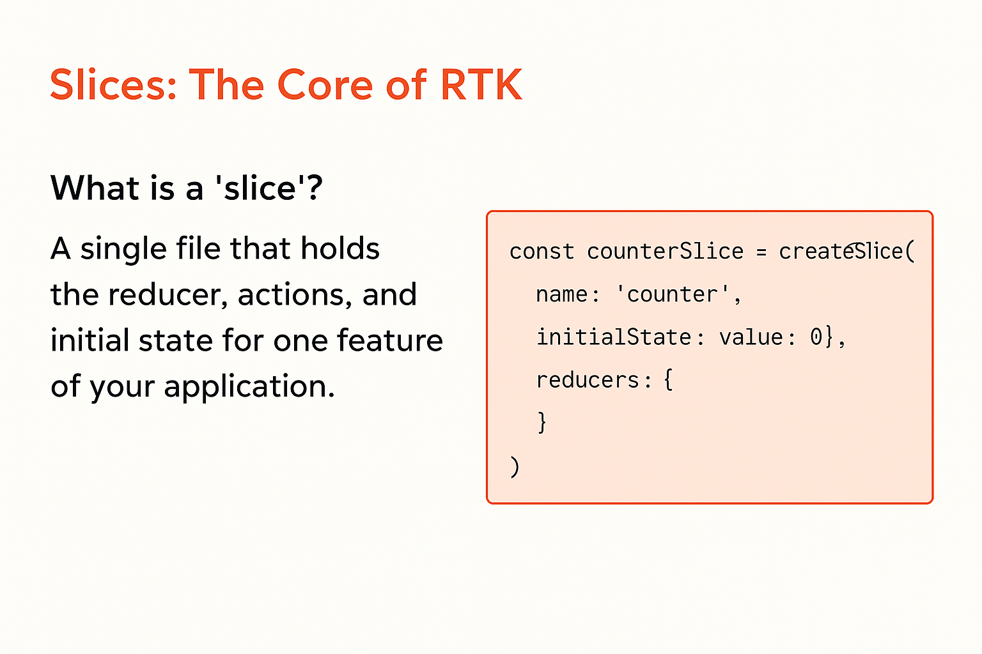

Slide 5
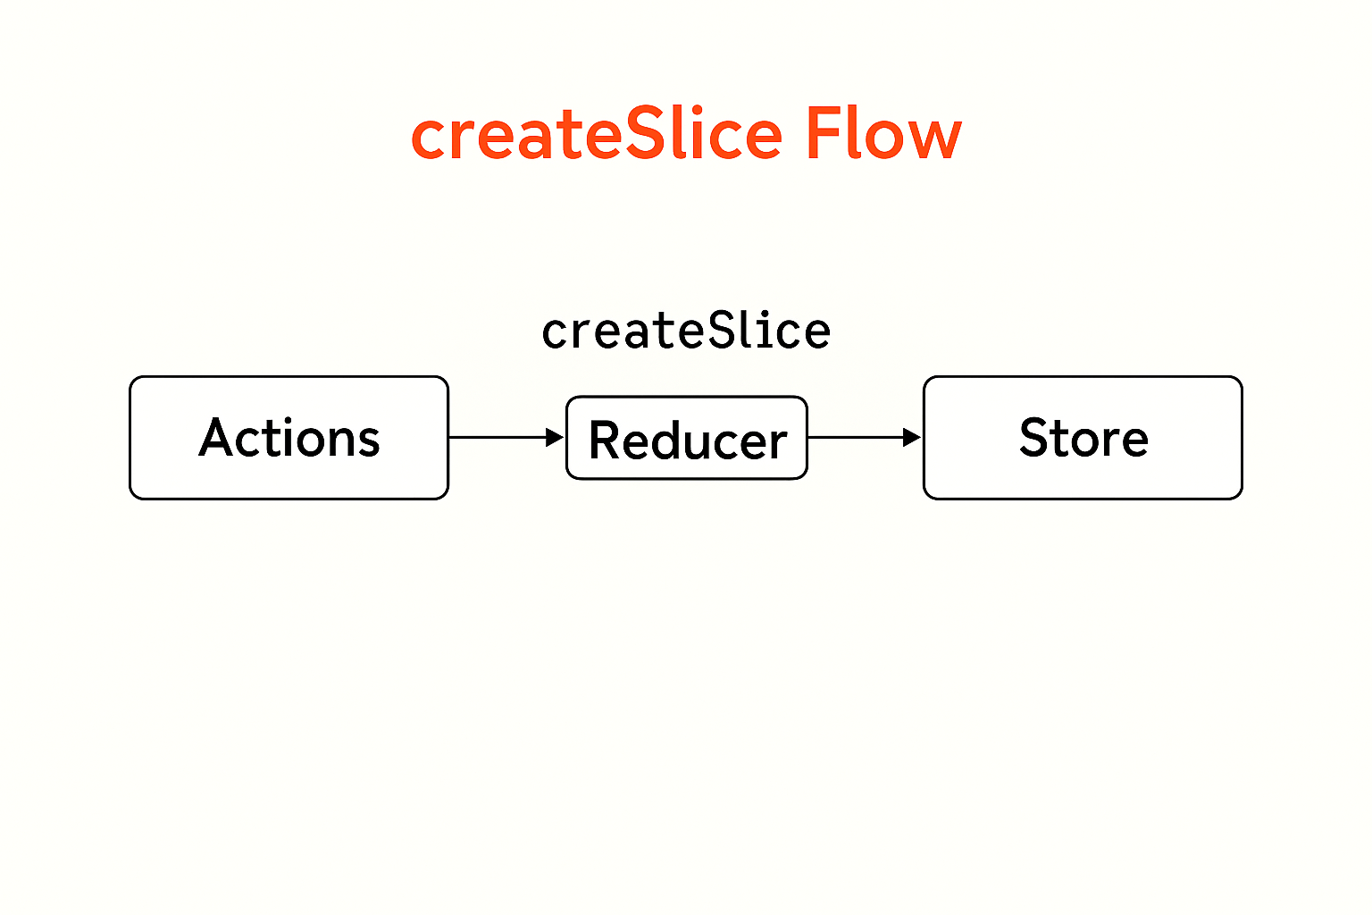

Slide 6
Create a "user profile" slice with reducers for updating name, email, and user role.
Hands-on Lab 2.1

Slide 7
2.2 Interacting with the Store (Hooks)
useSelector: How to read data from the store. Importance of using selectors and the reselect library for performance optimization.
useDispatch: How to dispatch actions to update the state.

Slide 8
Connect the user profile slice to a React component to display and update user information.
Hands-on Lab 2.2

Slide 9
Next up:
Handling Asynchronous Operations

